Slide 1

Attention Comparisons on RTX 5080
A Pareto Replication Study · FP32 → NVFP4 · RTX 5080
Refik Can Öztaş · N25142279
Ali Talip Coşkun · N25123060
CMP 674 – Parallel Computing with GPUs · Hacettepe University

Slide 2


WHY DOES THIS MATTER?
LLM costs are GPU costs. GPT-4 training cost was estimated at ~$100M.
▪
$700K/day serving cost for ChatGPT (2023 estimates)
▪
>90% of infrastructure spend is tied to GPU hours
▪
O(N²) complexity makes Attention the primary bottleneck

Slide 3

THE MECHANISM
What makes it powerful — and computationally expensive.

Slide 4






TWO HARDWARE CHALLENGES
MEMORY BANDWIDTH
ARITHMETIC THROUGHPUT
STRATEGY
N=8192, FP32 requires 4.3 GB of intermediates. HBM reading/writing is the true bottleneck, not arithmetic logic.
Matmuls dominate FLOPs. FP32 ALU is ~50x slower than FP16 Tensor Cores. Narrow precision doubles throughput.
Avoid materializing large matrices while using the narrowest precision Tensor Cores can effectively handle.

Slide 5

THE FIELD'S EVOLUTION
ALGORITHMIC FUSION
PRECISION THREADS
•
2022: FlashAttention-1 (Fused kernel, A100)
•
2017: FP16 Mixed Precision
•
2023: FlashAttention-2 (Partitioning)
•
2024: FP8 Attention (FA-3 / SageAttn)
•
2024: FlashAttention-3 (Hopper TMA, FP8)
•
2025: NVFP4 Attention (RTX 5090)

Slide 6
RTX 5080: THE RESEARCH GAP
Hardware Tier | FA-2 | FP8 Support | NVFP4 Support | Status
A100 (Ampere) | ✓ | — | — | Studied
H100 (Hopper) | ✓ | ✓ | — | Studied
RTX 5090 | ✓ | ✓ | ✓ | Studied
RTX 5080 | ? | ? | ? | This Study
RTX 5080 shares sm_120a with 5090 but has half the SMs and a narrower memory bus.

Slide 7
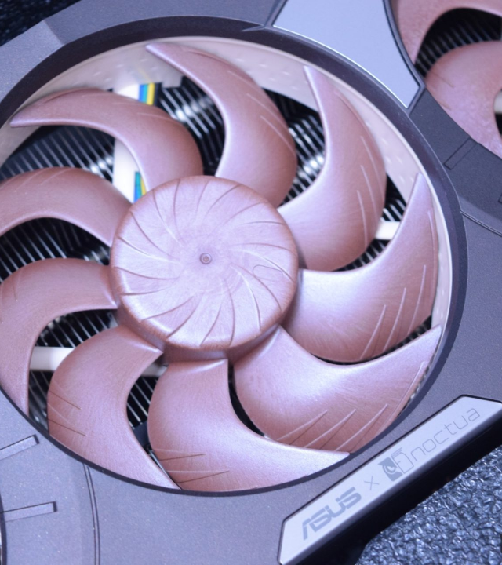
HARDWARE PROFILE
RTX 5080 Specs:
•
84 Streaming Multiprocessors
•
16 GB GDDR7 @ 960 GB/s
•
Native FP8 and NVFP4 formats
•
Lack of TMA (Tensor Memory Accelerator)
Research Question: How does the Pareto frontier shape up when adding fusion, FP8, and NVFP4 one variable at a time?

Slide 8





THE FIVE-STEP LADDER
V0
V1
V2
V3
V4
FP32 Naive Oracle Baseline
FP16 Tiled Tensor Cores
FP16 Fused Memory Fusion
FP8 Fused Compute Lever
NVFP4 Microscaled

Slide 9

V0 BASELINE & V1 TENSOR CORES
V0: FP32 NAIVE
V1: FP16 TILED
Oracle Reference.
HMMA.16816 Engagement.
•
3 separate kernel launches
•
Input FP16; Accumulate FP32
•
Full S and P materialized in HBM
•
CUDA WMMA used
•
Latency (N=2048): 4,500 ms
•
Latency (N=8192): 77.1 ms

Slide 10
V2: 17X MEMORY REDUCTION
THE FUSION LEVER
17x
Online softmax recurrence eliminates quadratic storage. No S or P ever written to HBM.
•
V1: 2,176 MB peak HBM
MEMORY GAIN
•
V2: 128 MB peak HBM
•
One fused kernel; block per row-tile

Slide 11
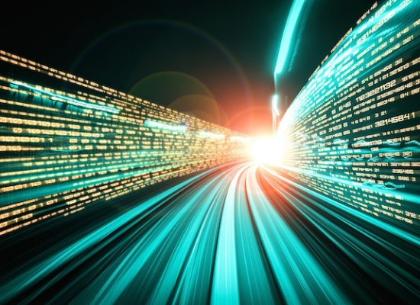
V3: 2.4X SPEEDUP VIA FP8
Engaging the Compute Lever with native Blackwell FP8 mma instructions.
•
Inputs quantized in-kernel to E4M3
•
Register-resident accumulator for output O
•
Latency: 25.8 ms (N=8192, D=128)
mma.sync.aligned.m16n8k32.f32.e4m3

Slide 12

V4: AN INFORMATIVE NEGATIVE RESULT
REGRESSION (0.77X)
THE BLOCKER
NVFP4 promised 2x over FP8. Our implementation (N=8192) recorded 33.4 ms vs V3's 25.8 ms.
Blackwell's native hardware-microscaled path requires specific ldmatrix-style swizzled SMEM layouts.
Software microscaling overhead wins over compute throughput on consumer silicon.

Slide 13
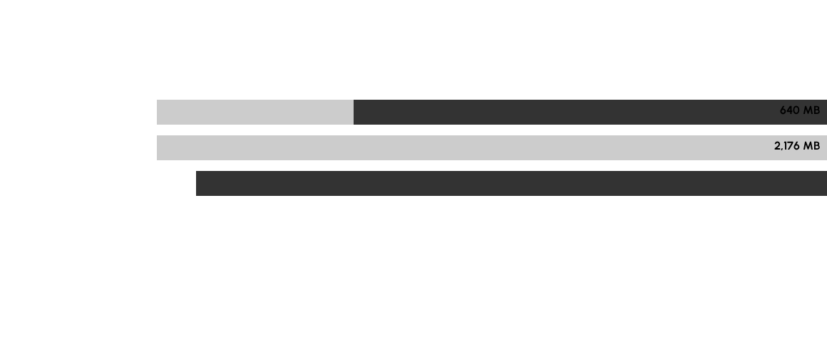
FINDING 1: PEAK HBM FOOTPRINT
Fusion breaks the memory wall. Precision is irrelevant to footprint once quadratic matrices are removed.

Slide 14
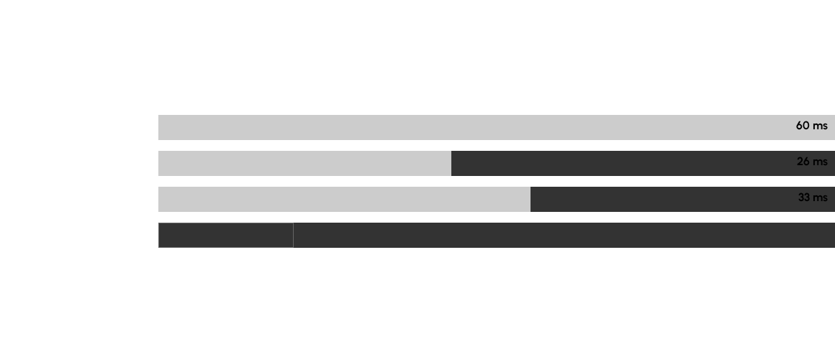
FINDING 2: LATENCY & PARETO FRONTIER

Slide 15



TAKEAWAYS
1. Fusion First: 17x win at V2 comes from restructuring, not precision change.
2. Layout is King: V3's speed required a PTX-specified fragment layout.
3. V3 Sweet Spot: FP8 is the current practical limit for consumer silicon.
4. Negative Results: Lower precision is not strictly better without hardware alignment.
github.com/canoztas/cmp674-attention-blackwell

